Slide 1
STARTuP
By:Diksha Rajput

Slide 2
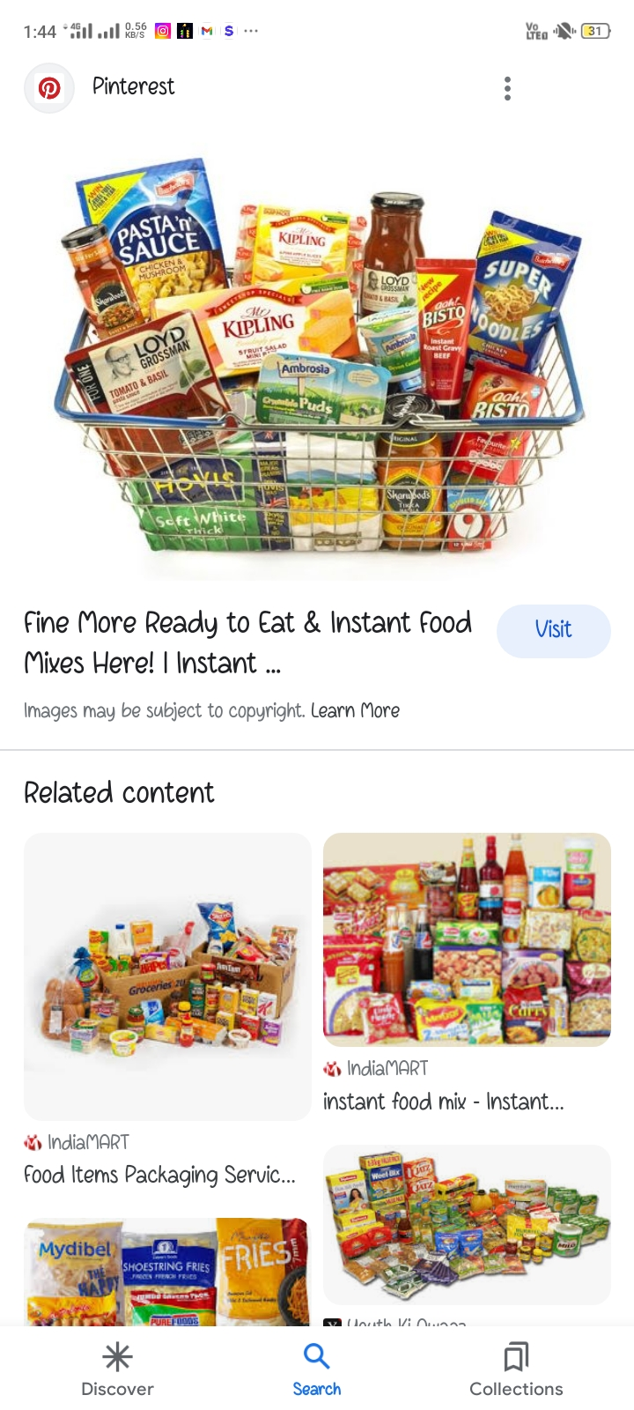
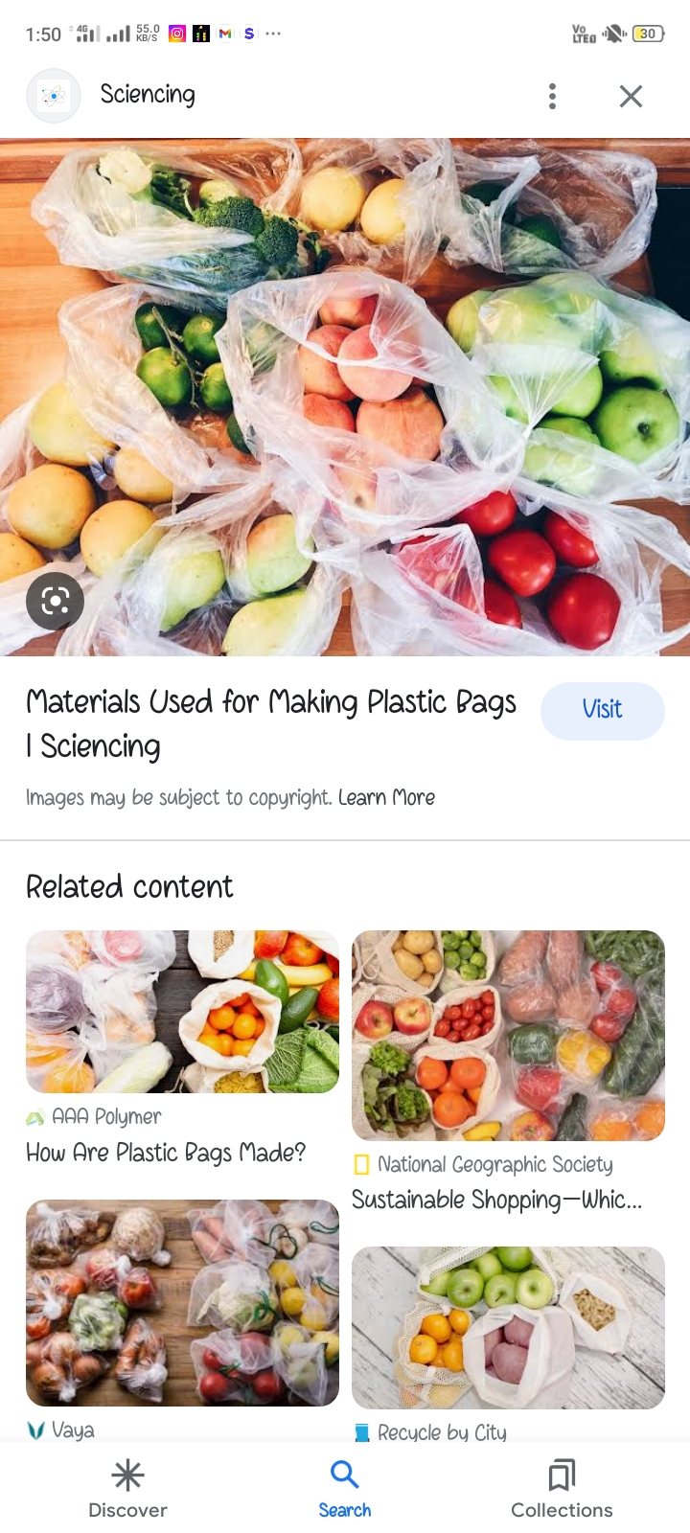
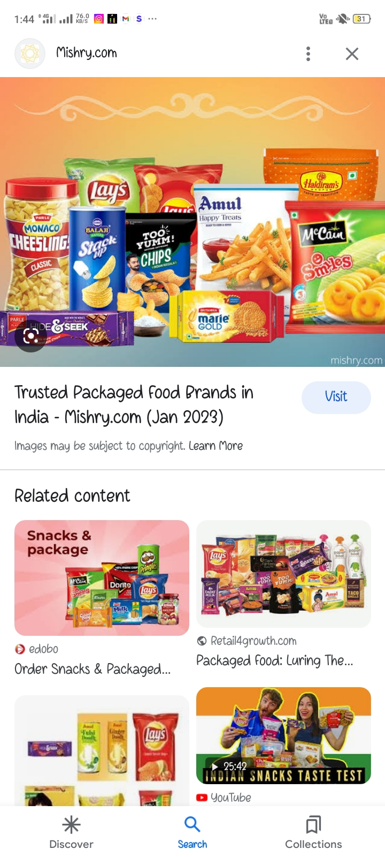
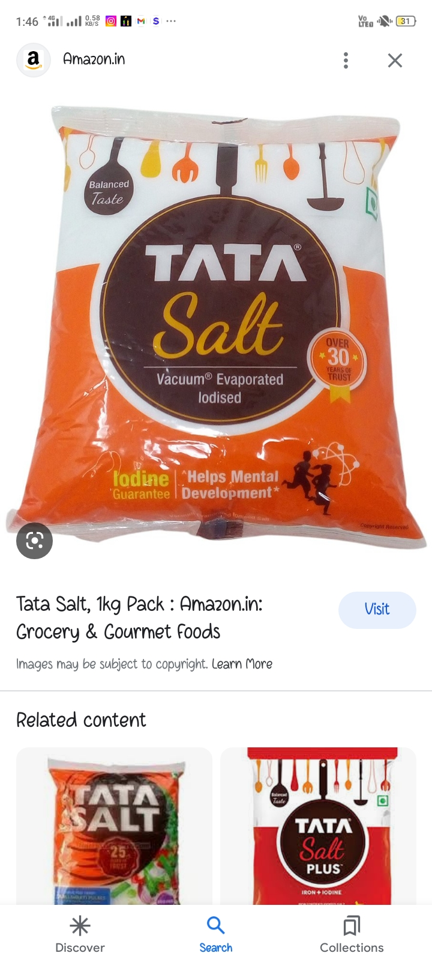
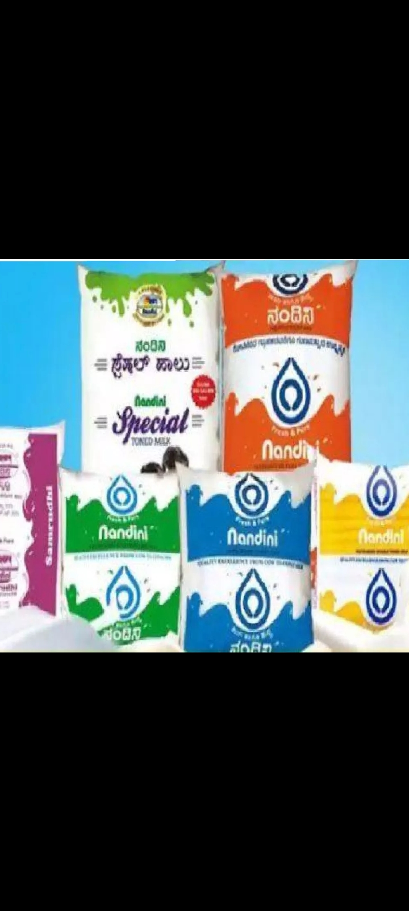
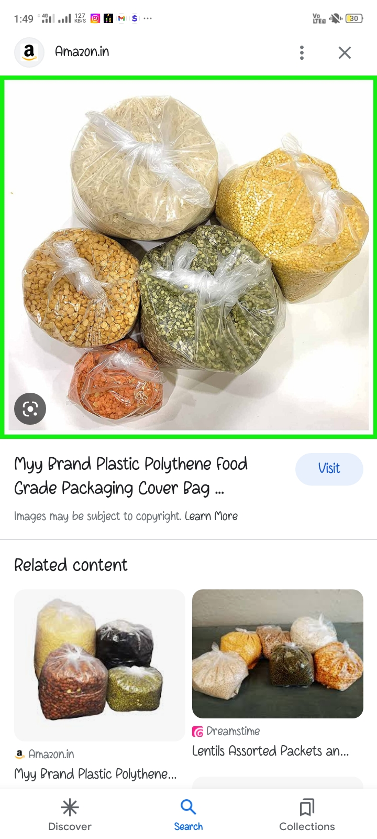

Slide 3
It is a waste management project . Specially the plastic bags poly bags
We clearly know that from nill to till everything is packaged in the plastic bags.like all eatables i.e. salt, biscuits and milk, oil almost 99% things comes in the plastic
We might through in dustbin after using them but WHAT'S THE NEXT…?
It is a huge problem of collecting plastic in our surrounding
A
B
O
U
T

Slide 4
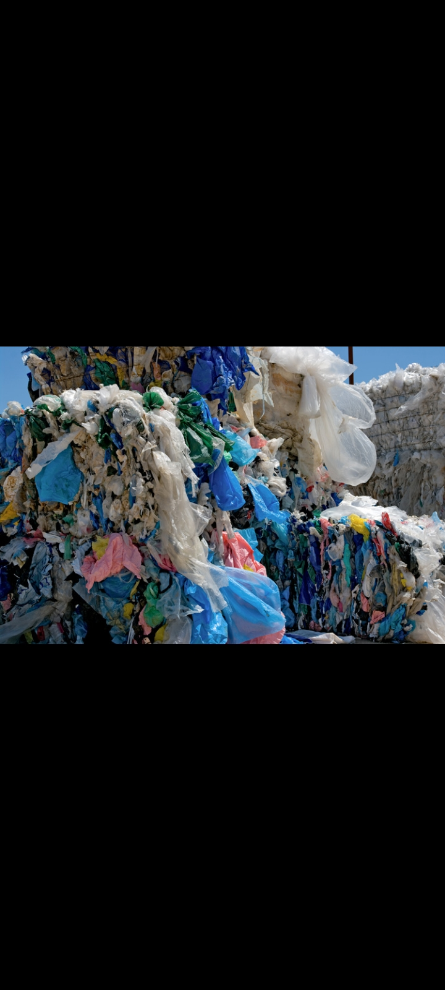
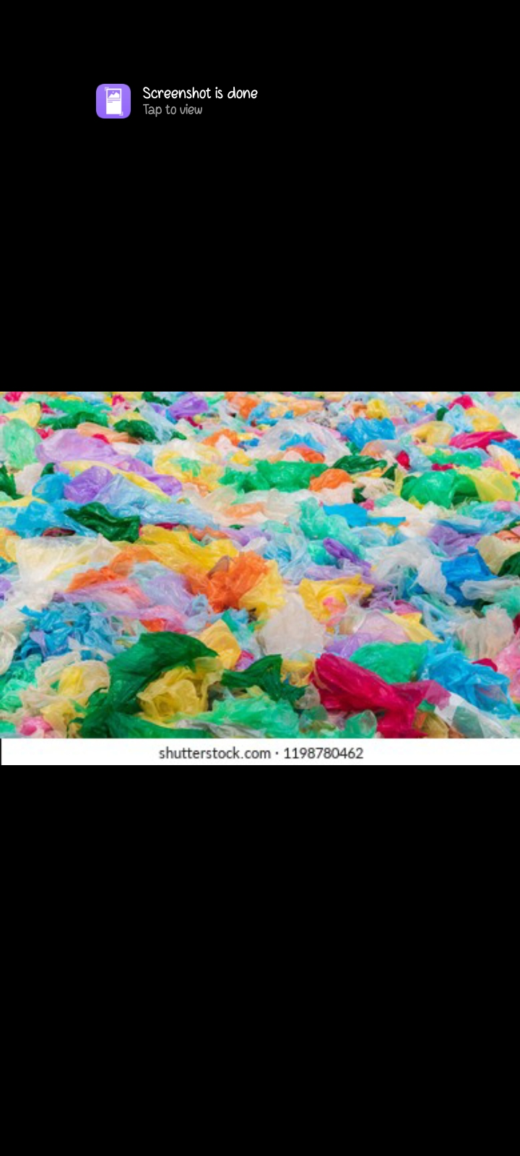
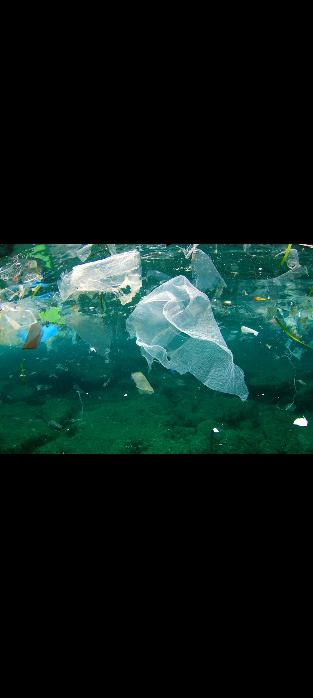
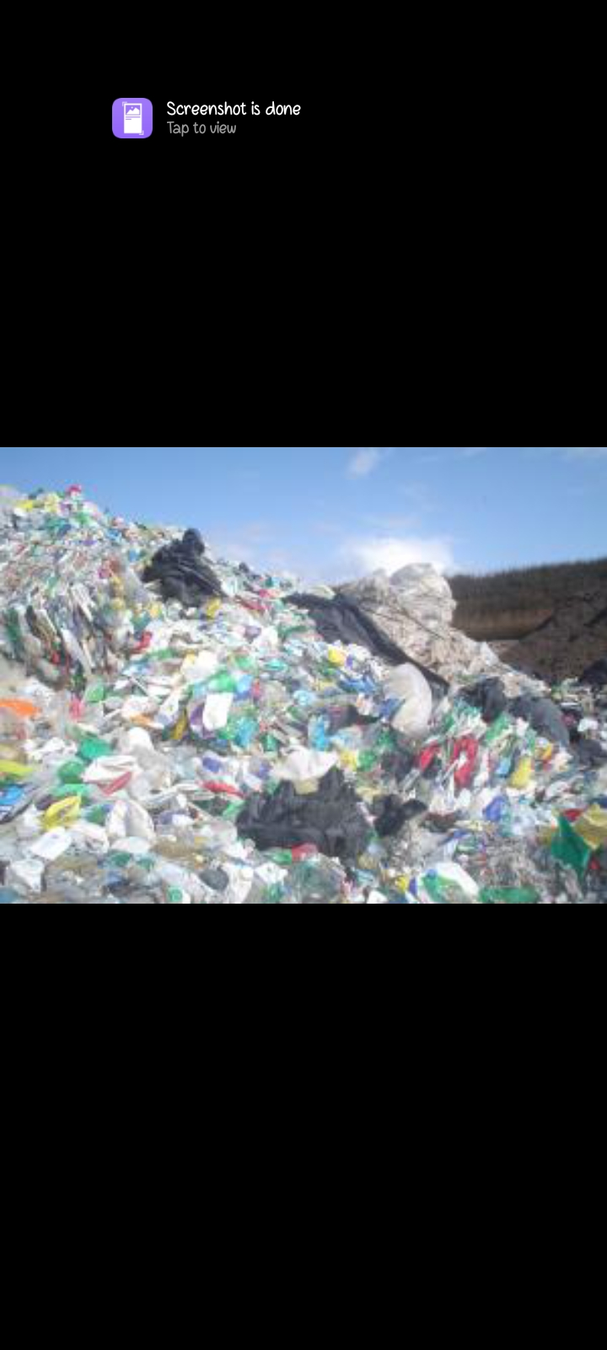
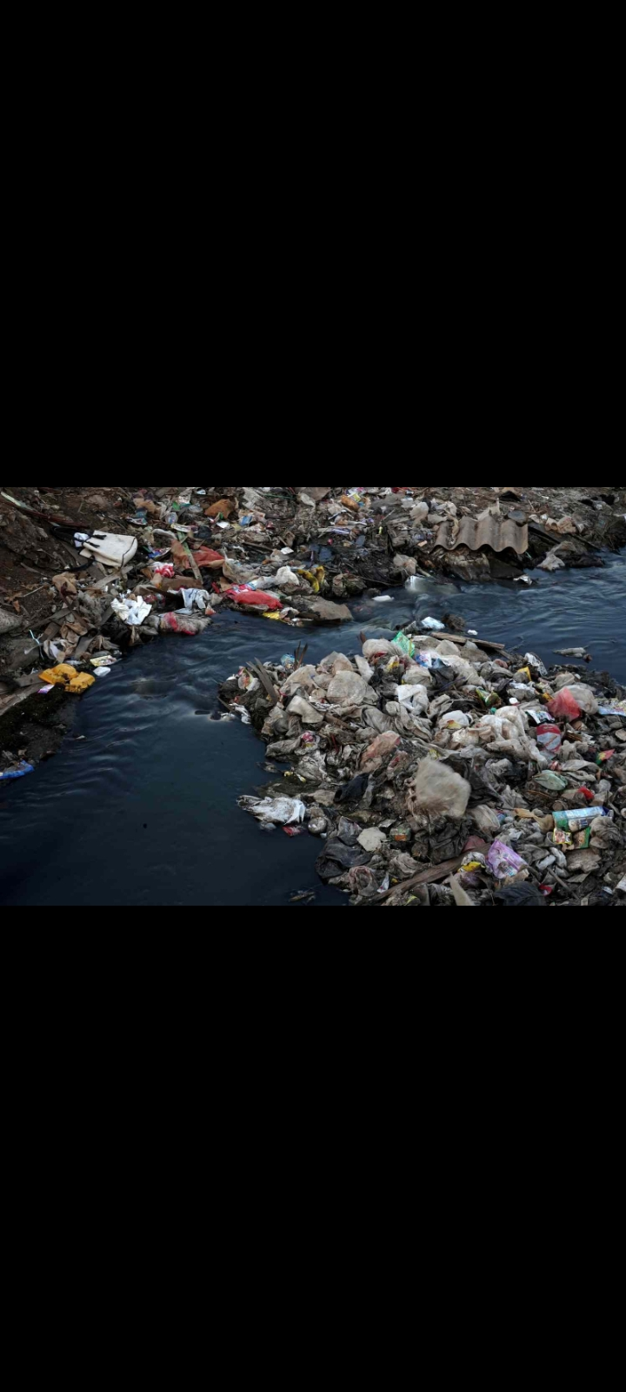
😟😥
LAs you can see😞

Slide 5
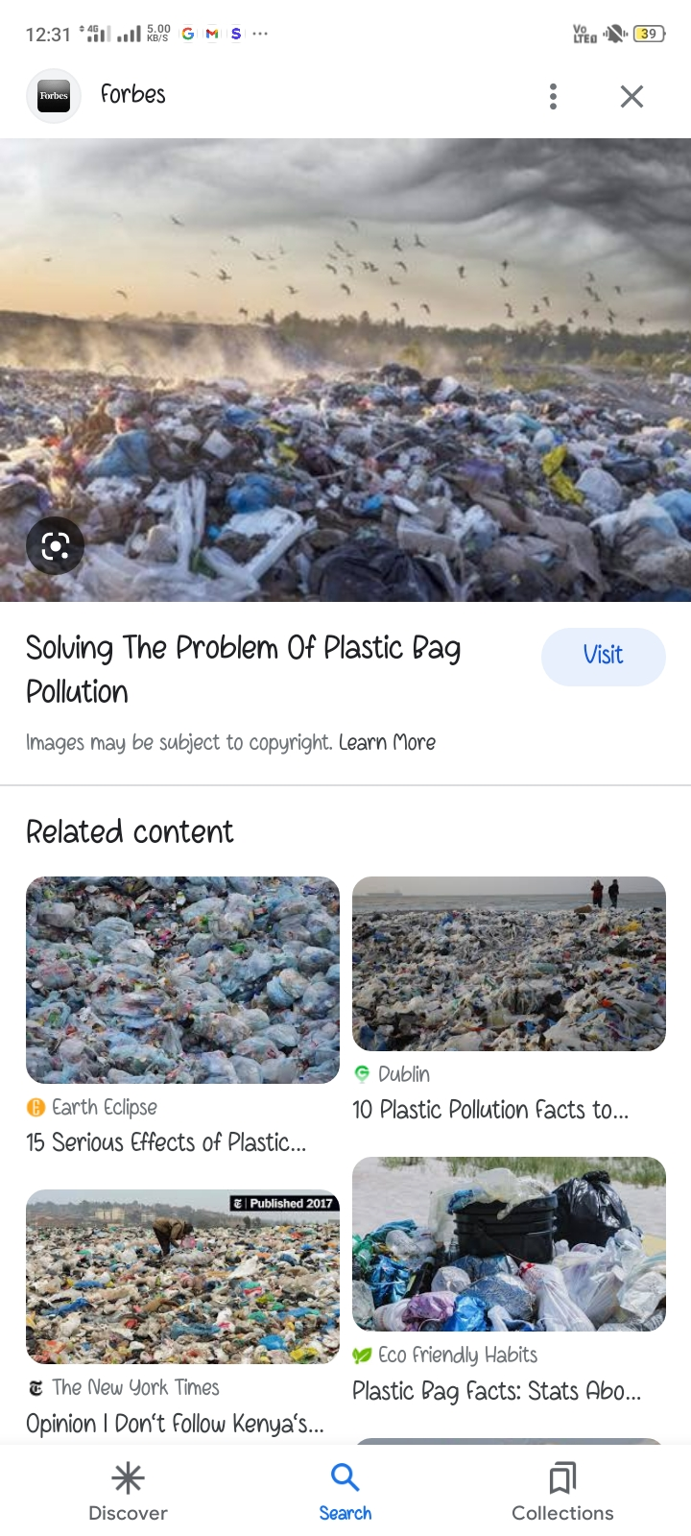
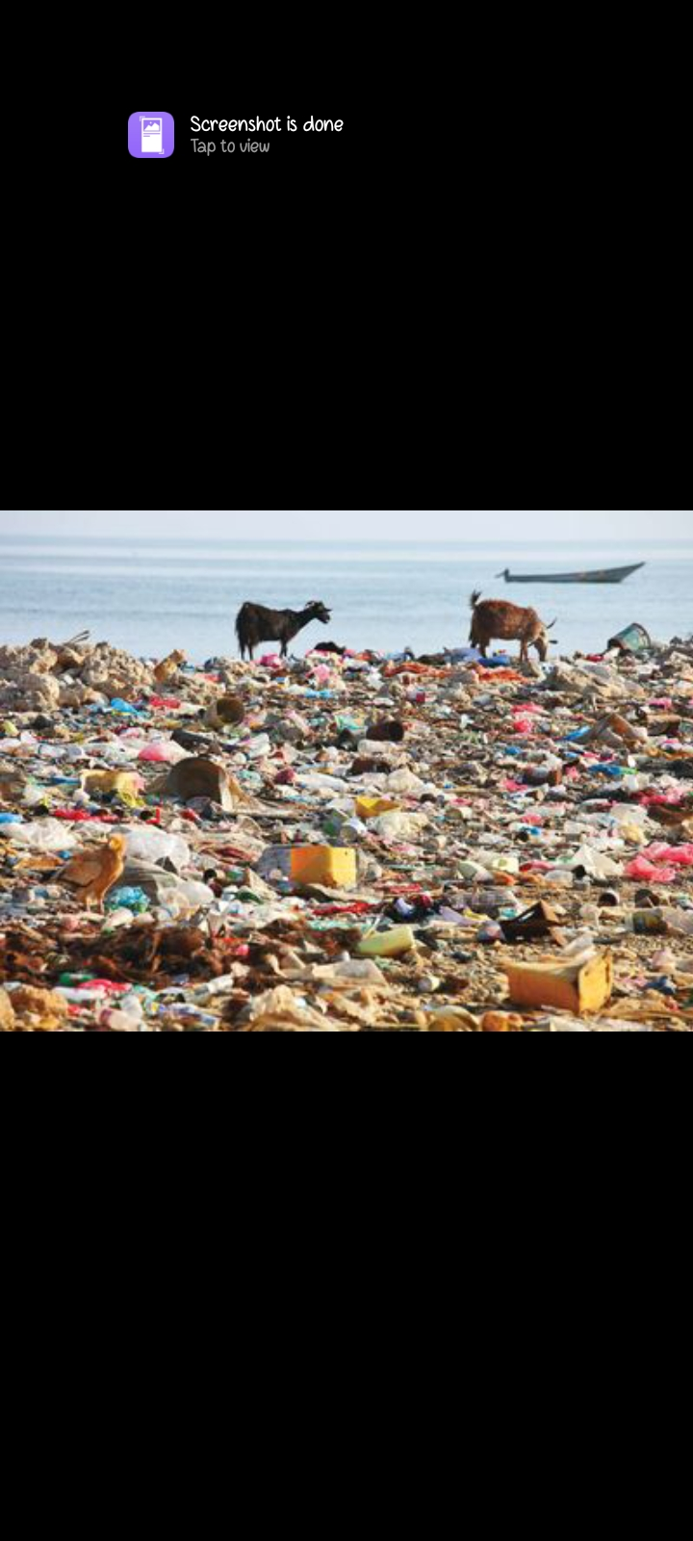
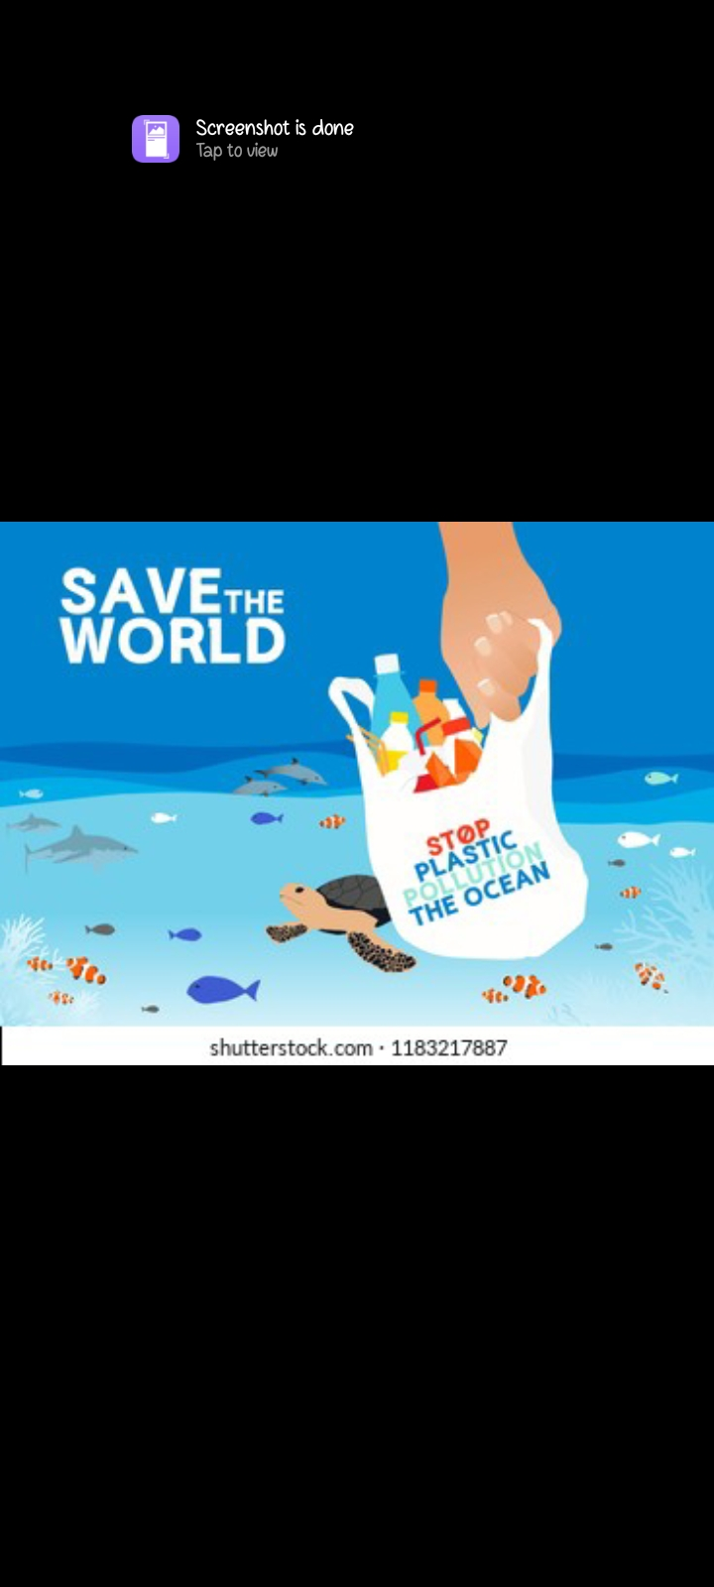
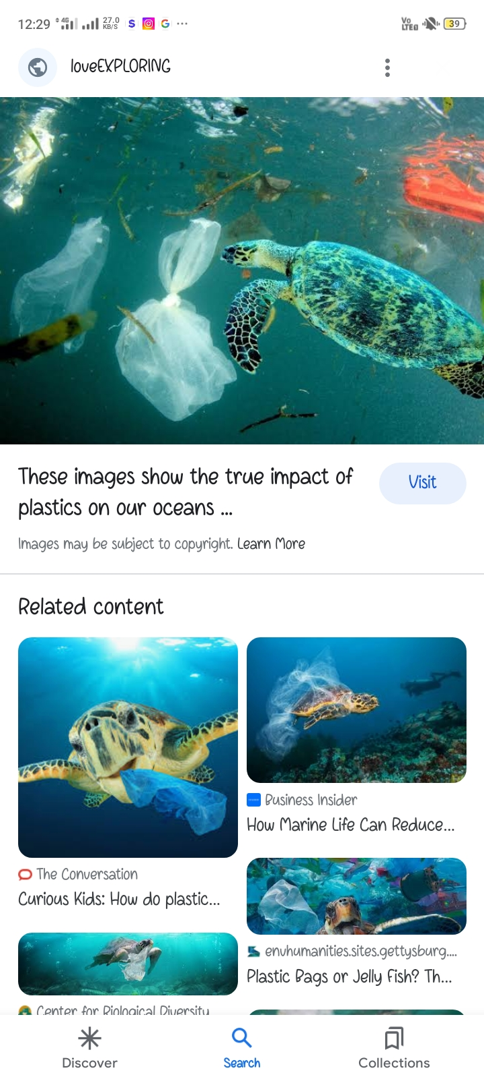
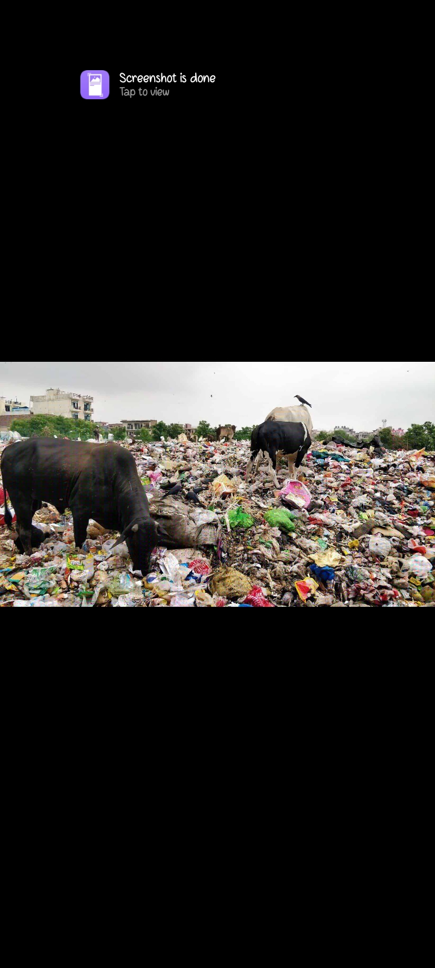
PROBLEMS

Slide 6
Come Be A Part of
Solution With Me…

Slide 7
**SOLUTION**
Looking this problem very seriously I have in solution of these plastic bags…
By some of the steps we can use or convert these plastic bags into a fashionable daily use things..
Not 1,2,3…. there maybe so many examples in which we can change a garbage into a useful thing like handbags, book cover ,slippers ,bottle cover ,laptop cover, dining table seats and etc ..

Slide 8
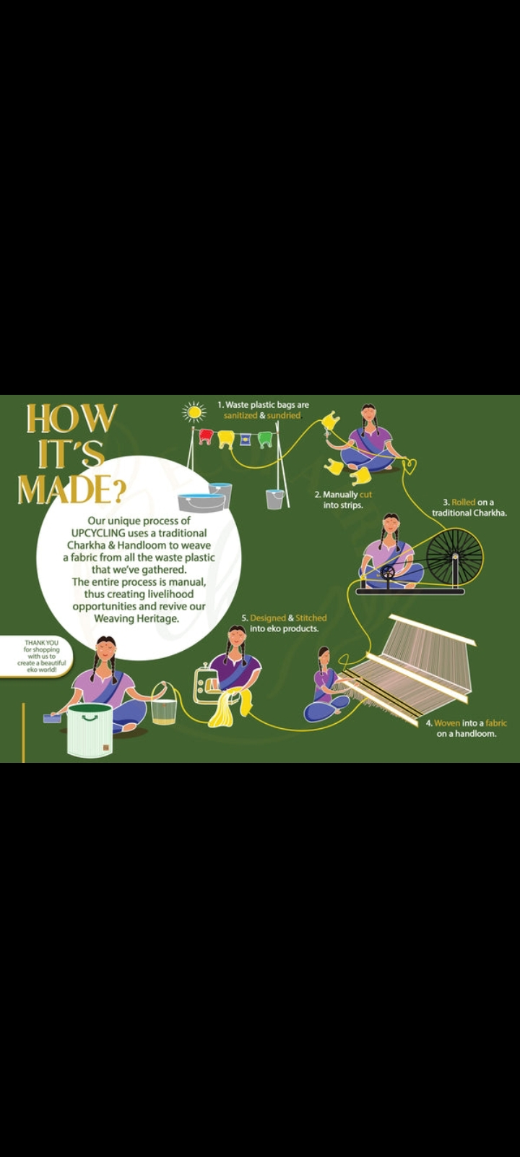

Slide 9
If I will explain the process it will take only 5 steps..
1 The very first step is sanitization manually, the waste plastic bags are sanitized and sun-dried
2 The second step is the cutting of these plastic bags into strips by manually..
3 moving forward we will roll on these cutting strips on a traditional charkha using charkha we can save electricity and proudly say made with our cultural style
4 Now here we have next step that is women into a fibre on a handloom
LHere we woven those strips into a fibre and that to manually with the handloom
5 Moving to the fifth steps where we design and stitch different eco friendly products with ; the super beautiful look and daily use product.
THANK YOU SO MUCH HERE WE HAVE THE FINAL PRODUCTS WITH US😊

Slide 10
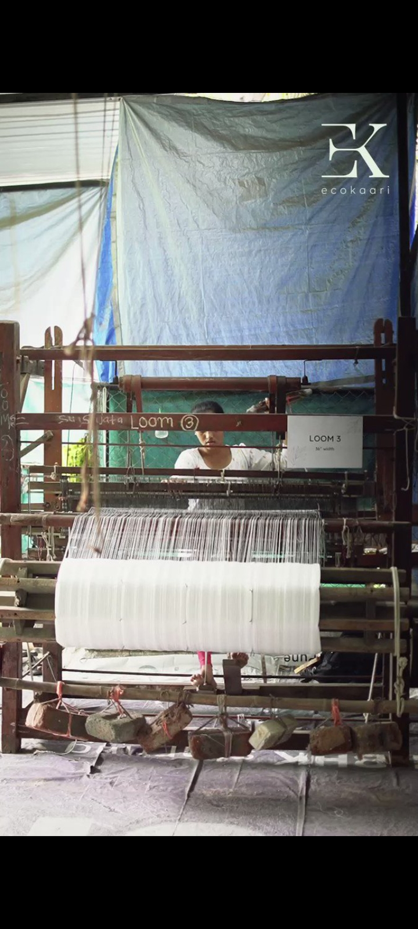
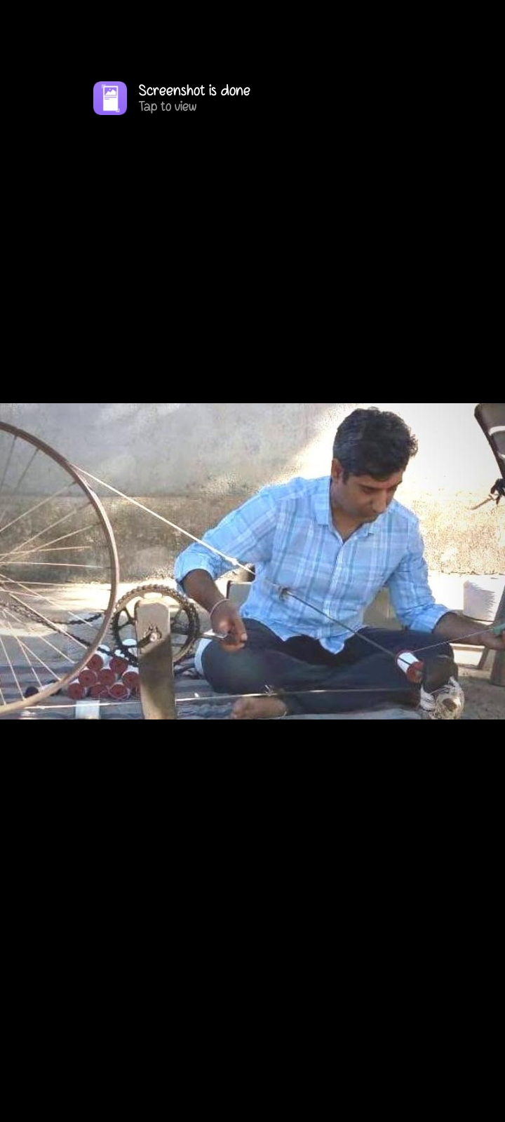
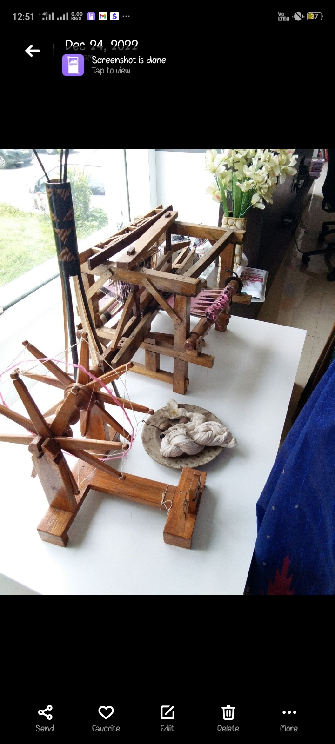
The Machines

Slide 11
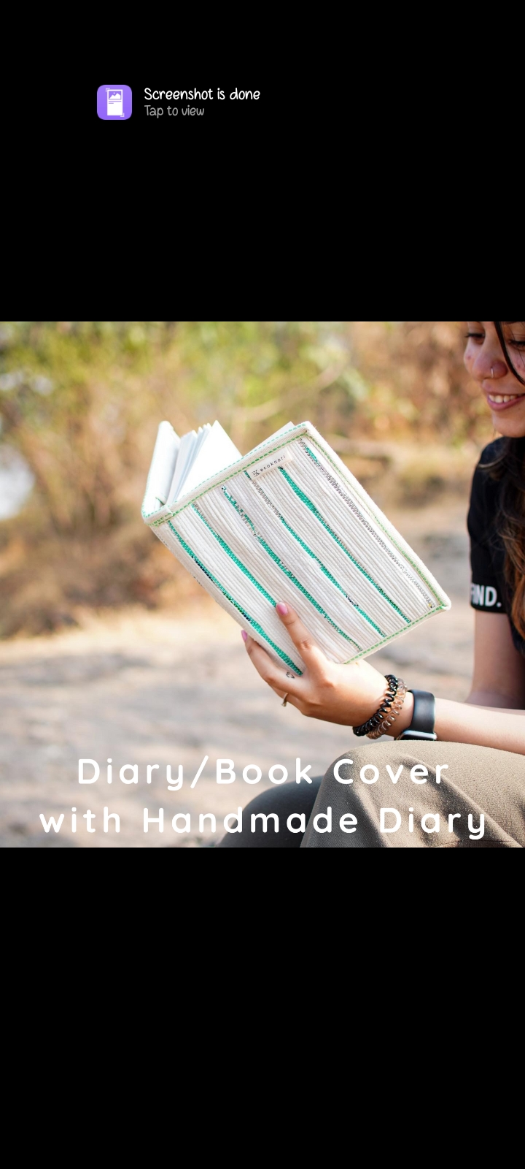
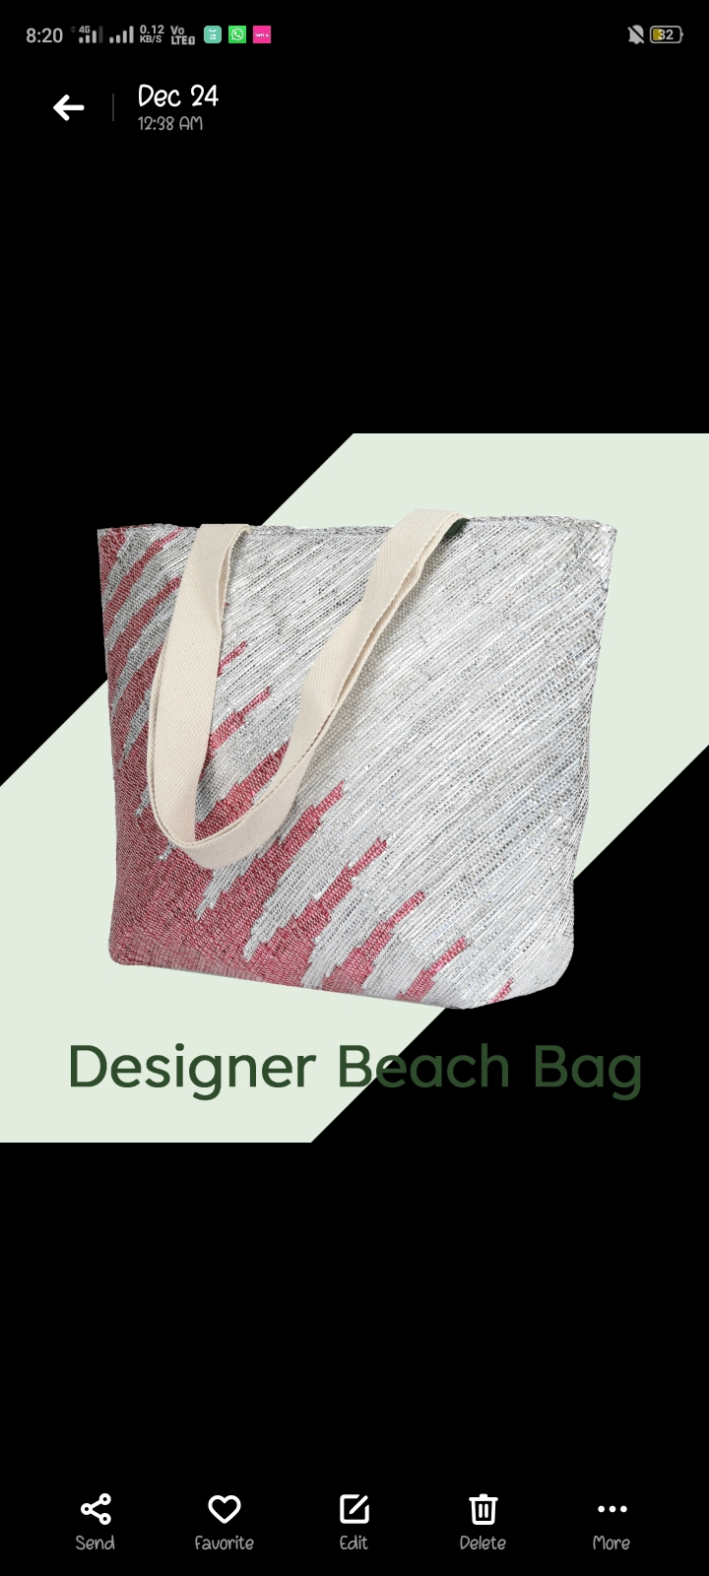
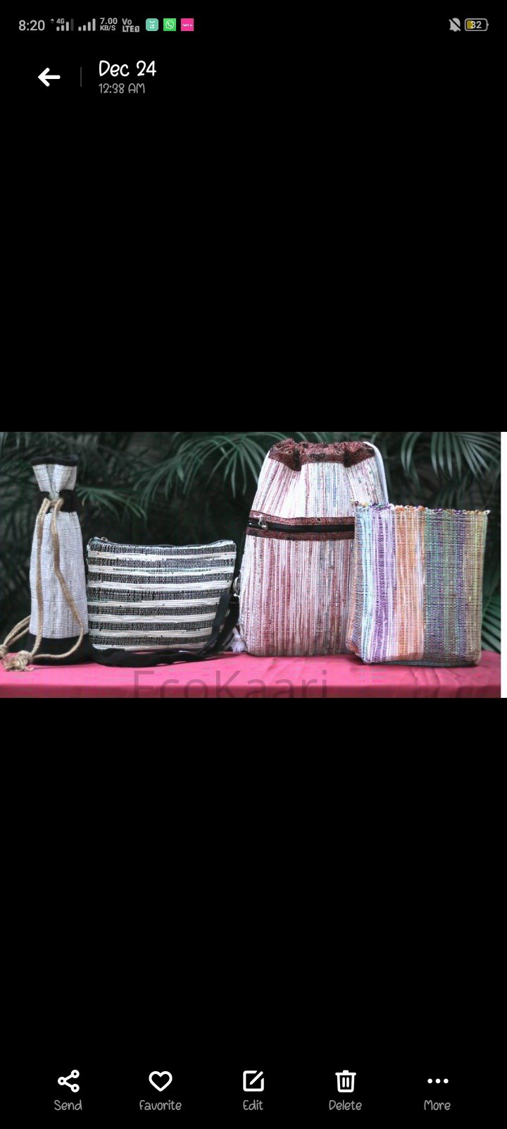
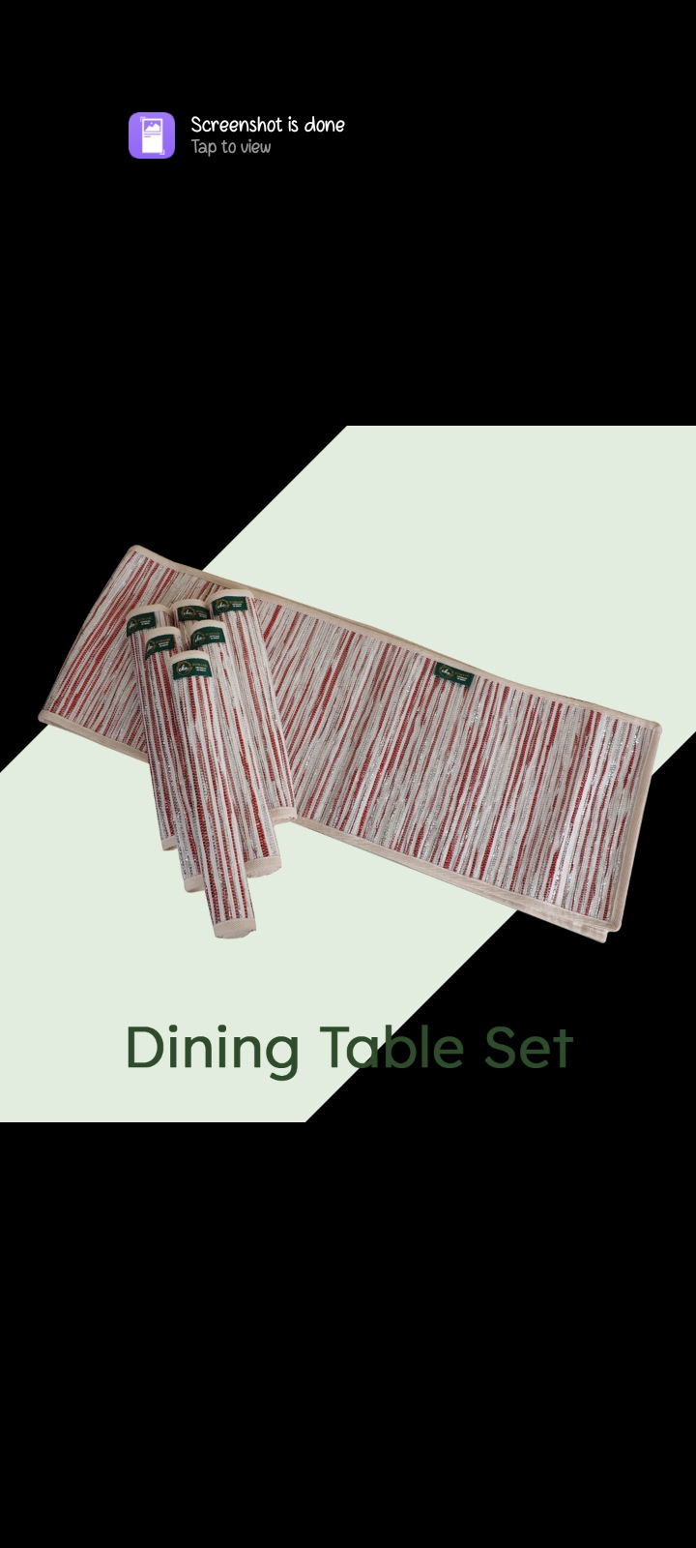
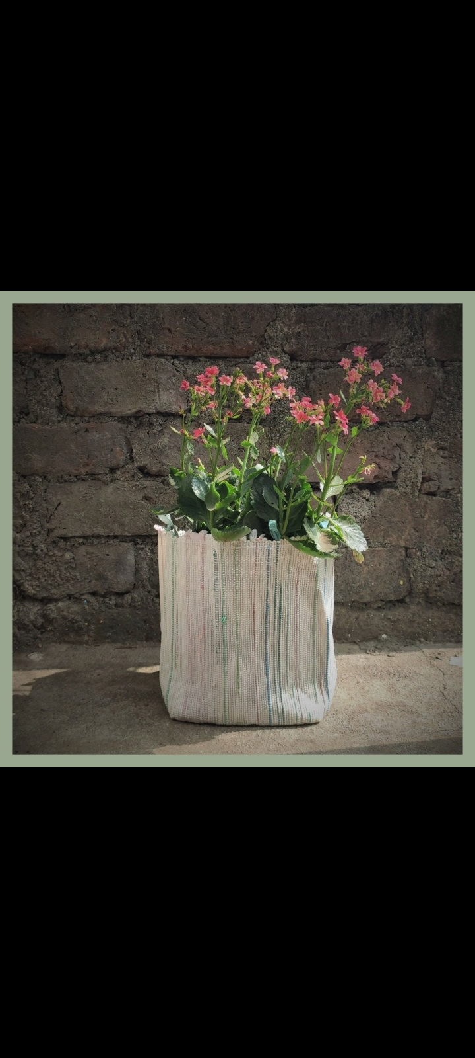
The Final Product

Slide 12
Benefits of this Project
The polythenes that no longer can be used are put to work rather then they ending up in ocean or landfill
Unskilled people get employment as this can’t be fully automated
People are aware about environmental problem hence these products are in spotlight
It does not have any type of Barriers, like geographical, languages etc
It has ability to solve people's problem which is actually used problem.
It has a huge market.

Slide 13
Companies already Doing Same Work
EcoKaari (since 2020)- Humanising Fashion
This is a company in Pune, Maharashtra. Nandan Bhatt, Founder and CEO and an enthusiastic envi
And Re-Charkha... .

Slide 14
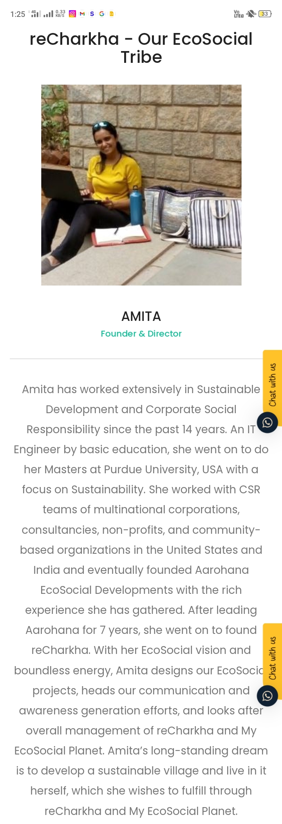
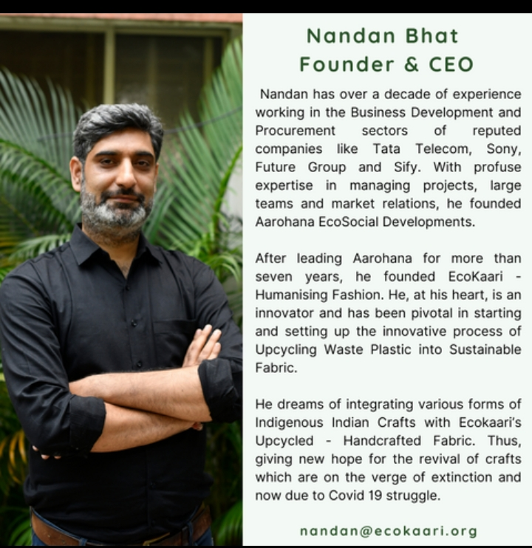

Slide 15
Thank You
Presentation given by the
Diksha Rajput
Contact: diksharajput09057@gmail.com
7772077490

